Slide 1
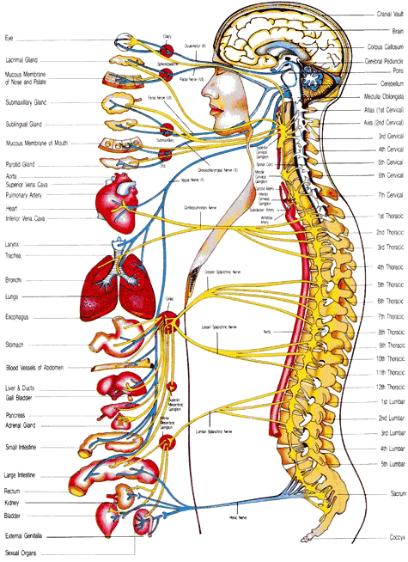
Peripheral Nervous System
Day 6

Slide 2
PNS
Nerves that branch out of CNS
Includes:
Cranial Nerves-arise from brain
Spinal Nerves-arise from spinal cord
Subdivided
Somatic Nervous System (SNS)
Cranial and spinal nerves that connect CNS to skin and skeletal muscles, Conscious activity
Autonomic Nervous System(ANS)
CNS to viscera (organs), unconscious activites

Slide 3
Cranial Nerve Songs
http://www.youtube.com/watch?v=4xzQ5vnvL-o
http://www.youtube.com/watch?v=ncs1EKJa648

Slide 4
http://www.youtube.com/watch?v=MAOXkzjtmn8
Cranial Nerves from Kirkwood

Slide 5
Cranial Nerves
12 pairs
Arise from underside of brain
All originate from brain stem except 1st pair (cerebrum)
Most are mixed nerves but some are strictly sensory or motor
Name and Number
Number is assigned based on where they arise from in order from front to back of the brain
Name describes primary function/general distribution of fibers.

Slide 6
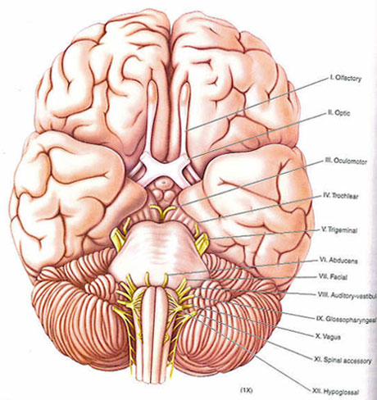
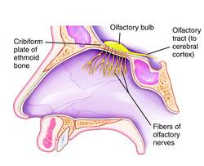
CN #1 Olfactory Nerves
Associated with sense of smell
Only sensory neurons

Slide 7
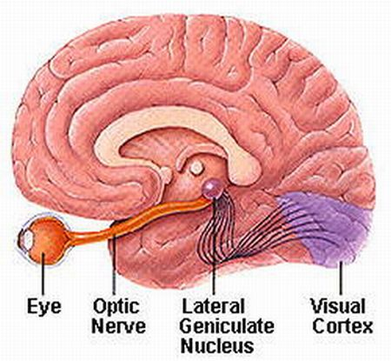
CN#2 Optic Nerves
VISION

Slide 8
CN #3 Oculomotor Nerves
Voluntary-Raises eyelid, moves eye
Involuntary-adjust light entering and focuses lens

Slide 9
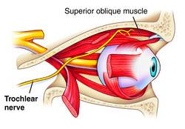
CN #4 Trochlear Nerves
Smallest
Moves parts of eye that #3 doesn’t

Slide 10
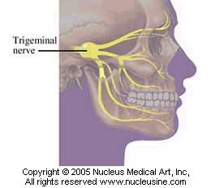
CN #5 Trigeminal Nerves
Largest
3 divisions
Ophthalmic: brings impulses to brain from surface of eye lids, tear glands, skin on anterior scalp, forehead, and upper eyelids
Maxillary: carries sensory impulses from upper teeth, upper gum, upper lip, mucus lining of palate, and skin on face
Mandibular: both motor and sensory fibers
Sensory-import from behind ears, skin of jaw, lower teeth, lower gum, and lower lip
Motor-muscles of mastication (chewing) and in the floor of the mouth

Slide 11
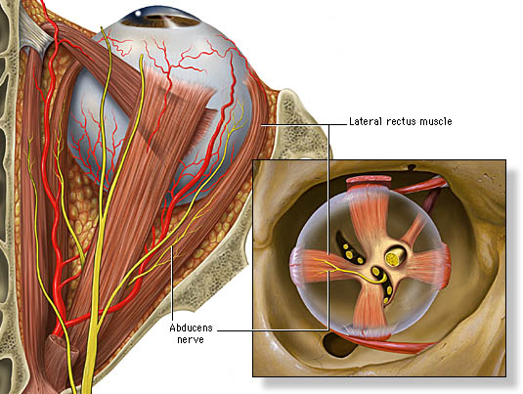
CN #6 Abducens Nerves
Small
Supplies rest of motor impulses to move eye

Slide 12
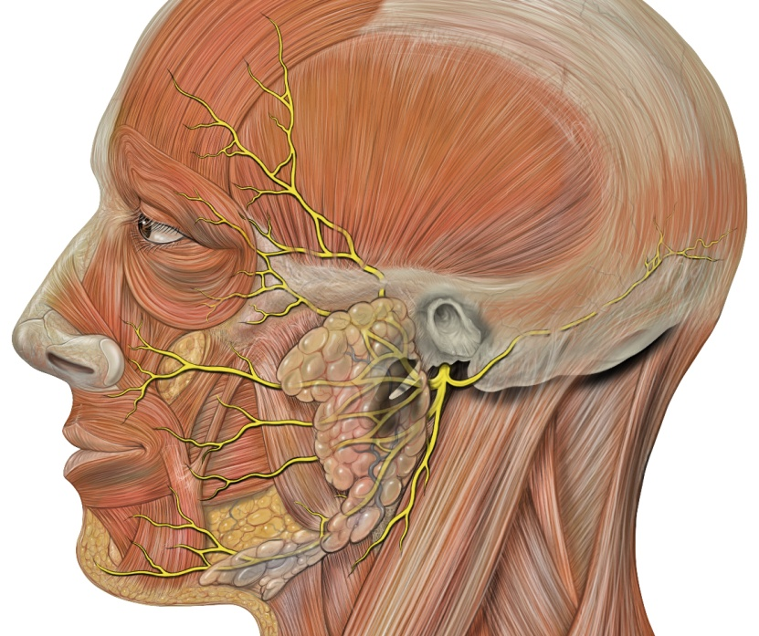
CN #7 Facial Nerves
Associated with taste receptors on anterior 2/3 of tongue
Motor impulses for facial expression
ANS-secretion of salivary and tear glands

Slide 13
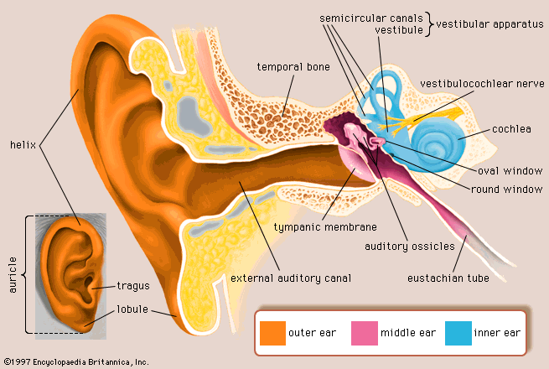
CN #8 Vestibulocochlear Nerves
2 branches
Vestibular: inner ear, aid reflexes to help maintain equilibrium
Cochlear-inner ear, house hearing receptors

Slide 14
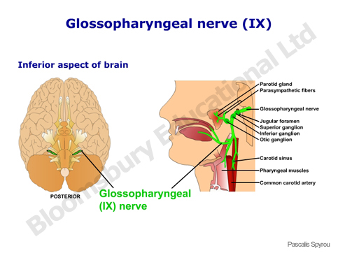
CN #9 Glossopharyngeal Nerves
Tongue and Pharynx
Carry impulses from linings of pharynx, tonsils, posterior 1/3 of tongue to brain
swallowing

Slide 15
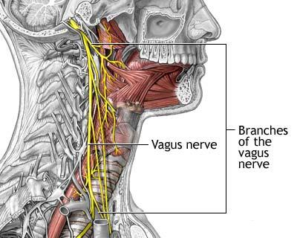
CN #10 Vagus Nerves
Both SNS and ANS
SNS-carries impulses to muscles of larynx, speech and swallowing
ANS-Supply heart and many smooth muscles and glands in thorax and abdomen.

Slide 16
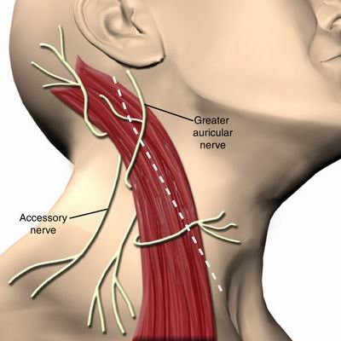
CN #11 Accessory Nerves
Cranial branch joins vagus nerve and carries impulses to soft palate, pharynx, and larynx
Spinal branch supplies motor fibers to trapezuis and sternocleidomastoid muscles

Slide 17
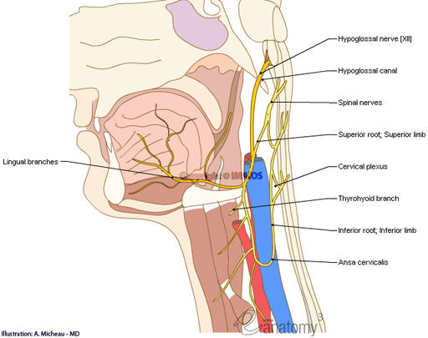
CN #12 Hypoglossal Nerves
Move tongue in speaking, chewing and swallowing

Slide 18
Review
Describe the PNS
Distinguish between somatic and autonomic nerve fibers
Name the cranial nerves, and list the major functions of each. (QUIZ NEXT CLASS OVER ALL 12)

